Slide 1
Recognition of Tomato Leaf Disease Utilizing improved Efficient V2 Convolutional Neural Networks

Slide 2
Abstract
It is aimed to identify the diseases affecting tomato plants by putting pictures of healthy and sick tomato plants into different groups using the modified version of Efficient Net V2. The most important findings demonstrated that the Efficient Net-V2 delivered an exceptional performance by achieving a 99.9% accuracy rate, indicating the potential for using CNN models to diagnose tomato diseases. This hybrid deep learning framework combines the best parts of deep residual networks and dense networks to reduce the number of training parameters while improving accuracy, sharing of information, and gradient. Existing networks were used to put the tomato dataset into groups, with the image attributes and hyper-parameters of the input images being changed.
Keywords – Tomato leaf disease, Deep learning, CNN, Efficient V2

Slide 3
Introduction
Tomatoes are a major source of revenue in India, and their production is projected to reach 20 million metric tonnes of tomatoes annually. Early diagnosis of tomato leaf disease requires a reliable and efficient automated approach, which can be achieved through deep learning algorithms.
Visual inspection by human specialists is required in traditional detection methods, which can be time-consuming and inaccurate. Because of this, early identification of tomato leaf disease requires a reliable and efficient automated approach. To gradually extract high-level characteristics from raw input, deep learning algorithms employ numerous layers of computation. From a different perspective, deep learning is the "computer modelling" or "automation" of the human learning process from a source (such as an image of a dog) to a learning goal (a dog).

Slide 4
Literature Survey
H. Li et al. proposed the method to identify illnesses in tomato leaves. The suggested approach successfully detected many tomato leaf diseases with high accuracy.
Wang et al.'s study compared several deep-learning methods for identifying illnesses in Tomato leaves, finding that not all approaches were equally useful. Deep learning is a powerful tool that can be used to extract classification tasks from a deep network. Common applications include identification and categorization of images and other objects. Three different CNN models (Resnet-50, Inception V2, and MobileNet-V1) were used to develop a system for detecting diseases and pests in banana leaves.
Sangeetha. R et al. developed a neural network for identifying and categorising tomato leaf states via transfer learning, with 95.75% accuracy attained via an AlexNet-based deep learning mechanism.

Slide 5
The Deep Leaf Disease Prediction Framework (DLDPF) is a framework that combines CNN with AlexNet and Google Neural Network cascade inception to automatically predict lead diseases. It is based on Cascade-inception-based deep CNN with transfer learning and is built with the help of Keras, TensorFlow, and Python data science platform. A lot of deep learning models, such as AlexNet, GoogLeNet, VGGNet-16, and ResNet-20, are compared to the DLDPF framework. Apple leaf datasets are used to analyse the results of the experiment.
CNN is a reliable way to identify and isolate grape leaf spots, based on the combination of a fine-grained GAN model and a region-based convolutional neural network (R-CNN). The best accuracy for forecasting grape leaf stain was obtained by ResNet-50, at 96.27 percent. To detect and diagnose leaf illnesses in tomatoes, Prajwala TM et al. demonstrated the use of a variant of the CNN model called LeNet, with an average accuracy of 94%-95%. Yan, Q., et al.'s Yan-Net and Modified U-Net were used to detect sheath blight (ShB) in rice leaves, and EfficientNet was used for disease classification in tomatoes. A basic CNN model was introduced to determine the health of tomato plants, which consisted of only eight hidden layers.

Slide 6
Piyush Juya et al. demonstrated improved and quicker detection of plant leaf diseases using R-CNN masks. VGGNet, LeNet, ResNet50, and Xception were used to train the networks, with three convolutional layers, a max pooling layer, and a filter layer or layers. PlantVillage contributed data collection and three different CNN models were used for transfer learning. AlexNet, DensNet161, and VGG16 were also employed for tomato disease diagnosis. TLD classification was created as a replacement for the popular pre-trained knowledge transfer ImageNet deep network model.
The proposed method for detecting tomato leaf diseases is based on the Efficient Net V2 architecture. It has an average classification accuracy of 91.2% for the nine illness classes and one healthy class, which ranges from 76% to 100% depending on the class. The filter learning architecture is made up of three convolutional layers and three maximum pooling layers, with the next two layers being two fully linked layers. The results of the experiments show that the proposed model does better than VGG16, InceptionV3, and MobileNet. The proposed method has the potential to serve as a valuable tool for the early identification and control of tomato leaf disease.

Slide 7
Dataset
The dataset is based on publicly available data in the website https://github.com/spMohanty/PlantVillage-Dataset, which includes 11,000 RGB photos separated into 10 categories, showing both healthy and sick tomato plant leaves.
The full dataset is split into a training and validation set with a 90:10 ratio, with each image having a resolution of 256 pixels by 256 pixels.
The nine illnesses included in the dataset are Bacterial spot, early blight, late blight, leaf mould, septoria leaf spot, two spotted spider mite, target spot, tomato mosaic virus, tomato yellow leaf curl virus. Different orientations, sizes, lighting conditions, scaling factors, textures, and patterns are used to enhance each individual feature.
This study will focus on specific plant diseases, like those that affect tomatoes, to test how well the proposed work works and do a full evaluation of the proposed task. Data for individual plants is extracted from this database and organised into separate data sets, so only a small number of sample plant images are utilised as input to detect plant illnesses.

Slide 8
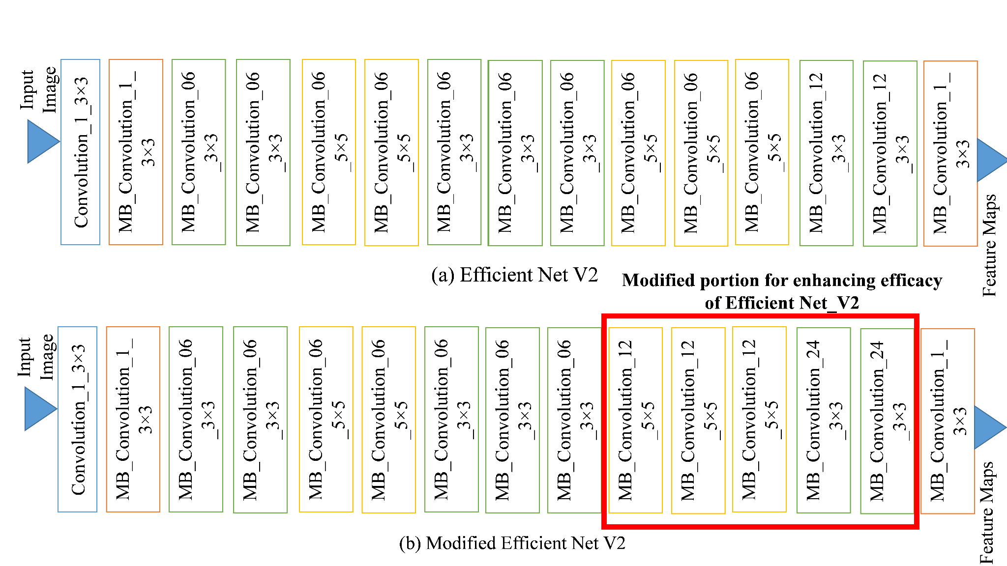
Proposed Methodology
The data used to train the model was extracted directly from the source using the gdown Python library.
For rapid prototyping of our CNN model, we utilised the hyperactive library, which provides values for hyperparameters that maximise the predictive accuracy of our model.
Data augmentation is a technique used to quickly prototyping a CNN model using the gdown Python library, hyperactive library, NumPy library to conduct mathematical and logical operations on arrays, and the Albumentations library for data augmentation.
Data augmentation increases the number of images to prevent overfitting and generates training images using various processing techniques.
Fig.1 Proposed Block Diagram

Slide 9
The efficient net V2 model uses the transfer learning process and the Head Convolutional Layer to take the results of the work done by the preceding layers and do something useful with them.
A global pool averaging layer, a fully linked layer, and a softmax layer are used to place the picture into one of many categories.
Batch normalisation and drop out layers are also employed to ensure a seamless dimensionality reduction and enhance the training procedure.
The Normalised Linear Unit (ReLU) is a non-linear activation function that reduces the range of parameters in a given characterization map.

Slide 10
The proposed Efficient Net V2 parameters, and pooling procedures are important for efficient connectivity and data handling. A 1x1 convolutional layer (the bottleneck layer) is thought to reduce the number of parameters determined at each level before a bigger kernel convolution filter is employed.
The 11 convolution layer further increases the network's depth, and the ReLU non-linearity activation function further enhances the performance.
The pooling layer swaps out completely linked layers for mediocre ones, reducing the need for parameters and resulting in an 11% increase in training size.
The proposed model makes key alterations such as using the Adam optimizer, providing the feature bank of a more comprehensive and expansive module, normalising the Auxiliary classifier's fully linked layer, and regularising Label Smoothing to alleviate a representational bottleneck.

Slide 11
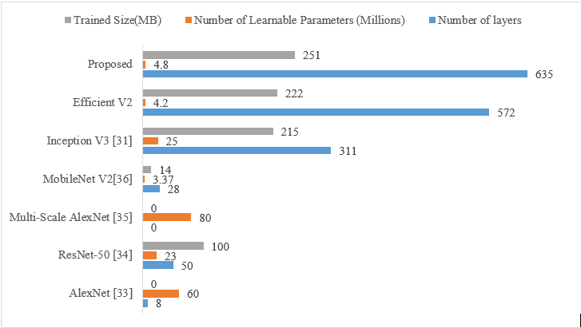
The resulting class is the one with the highest softmax probability.
Fig.2 A Comparative analysis on the several DL designs in terms of layer count and parameters

Slide 12
Although the current Efficient Net V2 makes use of factorised convolutions, smaller convolutions, asymmetric convolutions, and an auxiliary classifier, the proposed model makes the following key alterations:
Using the Adam optimizer, which combines the benefits of the stochastic gradient (SGDM) and the root mean square propagation (RMSprop) optimizer, instead of the RMSprop optimizer . The feature bank of a more comprehensive and expansive module can help alleviate a representational bottleneck. Information loss will be avoided as a result of this.
Batch normalisation in the Auxiliary classifier's fully linked layer Regularisation of Label Smoothing: It's a method for regularising a classifier through the estimation of label dropout's impact on the training process. It prevents the classifier from making false-positive predictions (over-fitting).
Training and testing label mappings are one-to-one. This is also known as "mapping" from the source to the desired destination.

Slide 13
Results
The new network uses inception layers and forward learning to train with minimal input data. Transfer learning improves generalization in another task by using information from a prior assignment. During this phase, the last layers are replaced with new ones like the linked layer and softmax classifier.
The training period is set to 100 iterations, at which point the accuracy of the model is checked. The default batch size of 32 means that 32 values will be processed simultaneously. The network uses a drop-out layer with a factor of 0.5 over three layers. During the back pass, weights are not updated and activation of downstream neurons is repressed at regular intervals of 50 epochs. The network's maximum learning rate is increased by this fall factor at this time of year. CNNs are trained using an Adam algorithm and adjustment weights, with a batch size of 128 for each iteration. Padding is performed throughout the sequence, L2 Regularisation is set to 0.0001, and the proposed design model's training error is diminished. The experiment's average training and testing accuracy is 99% with 0.017 loss, and the proposed model outperforms Efficient V3 by 0.84 and 0.8 %.

Slide 14
Table 1. Training Details
Parameters | Value
Training Epoch | 100
Batch Size | 32
Drop out | 0.5
Learning rate | 0.0001
Solver | Adam
Validation Frequency | 50
Minimum Batch Size | 128
Sequence Length | Max
Sequence Padding | Zero
L2 Regularization | 0.0001
Gradient Threshold | Infinity

Slide 15
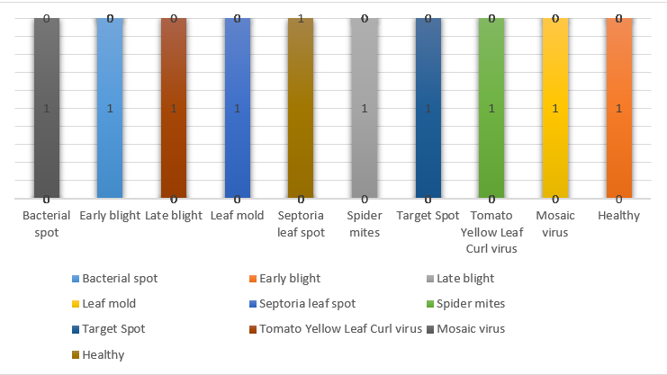
Fig. 3 Sample result of the Overall head

Slide 16
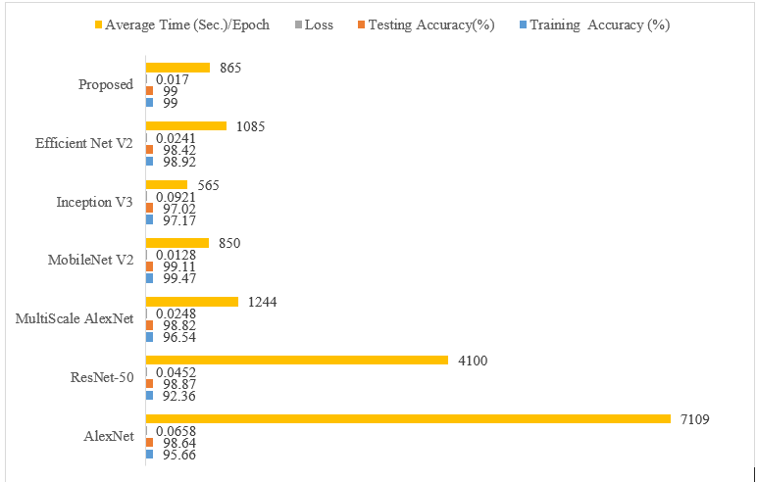
Fig. 4 Comparing the performance of various DL architectures.

Slide 17
Conclusion
This paper presents an enhanced version of the EfficientNet-v2 model for disease identification in tomato leaves. The proposed approach employs a transfer learning strategy derived from a modified version of EfficientNet-v2 on the tomato dataset in an effort to improve performance with fewer parameters. In experiments, the proposed model achieved an accuracy of 99.2% by splitting the tomato dataset into 90/10 subgroups. Measuring accuracy and prediction, the recommended deep-learning model improves upon the state-of-the-art by a mean of 6%. Transfer learning and data augmentation techniques can help with insufficient datasets, non-ideal robustness, symptom variations, image spectral variations, and adjusting the model's hyperparameters. This environment is ideal for investigating and applying DL approaches to the classification of plant diseases.

Slide 18
THANK YOU

